Slide 1


Predicting Water Pump Maintenance in Tanzania
Isabella Oakes
University of San Diego
Master of Science, Applied Data Science
ADS-501
03/01/2021

Slide 2
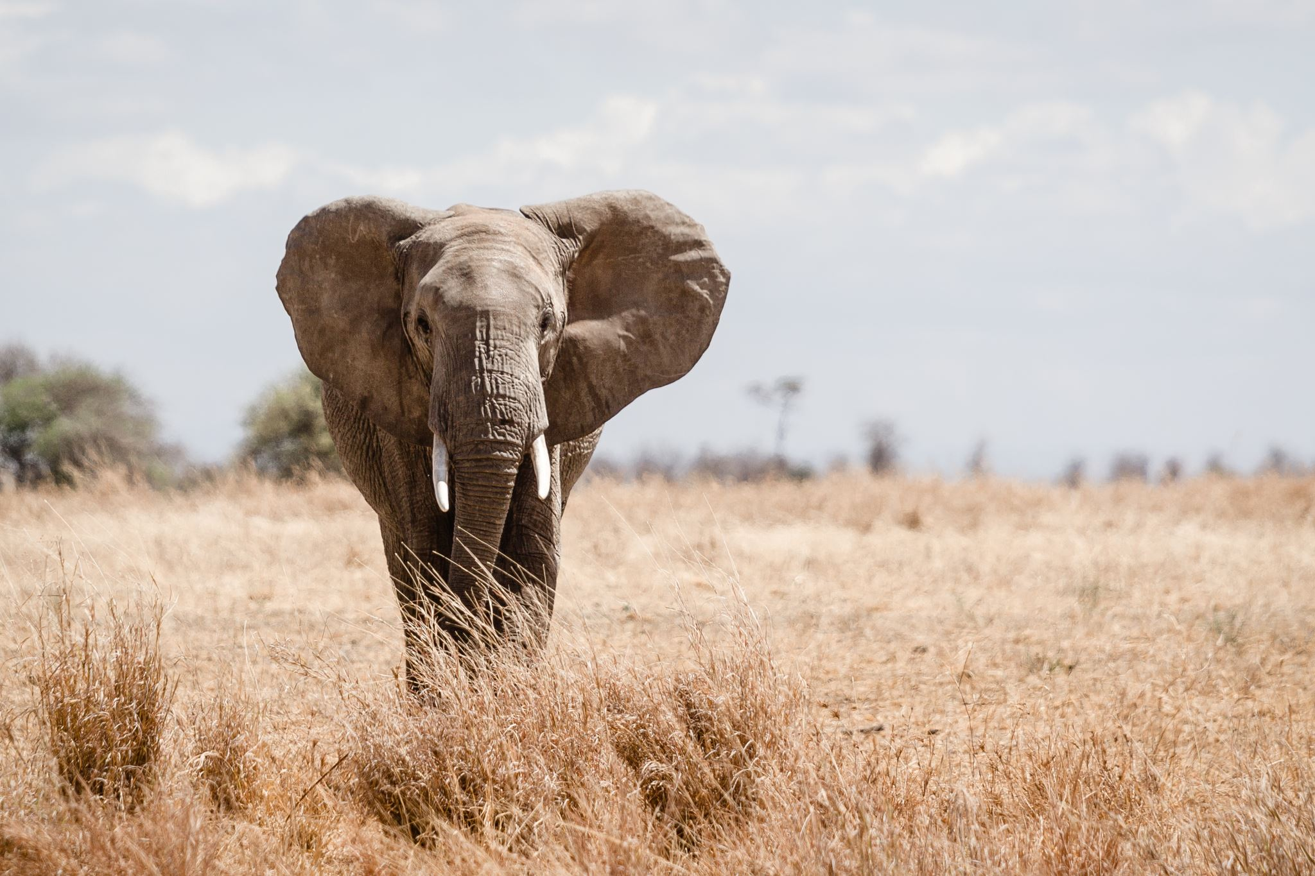
Tanzania
Low rainfall
Population of 57 million
4 million don’t have access to potable water
30 million don’t have access to sufficient sanitation

Slide 3

Waterpoints in Tanzania
Taarifa is requesting help with predicting waterpoint status
Over 50,000 waterpoints
Create a model to determine waterpoint status

Slide 4

Project Features
39 variables
Quality of information is assumed to be consistent
Data used to create model is gathered from 2011-2013

Slide 5

Project Goals
Model will make predictions for at least 95% of waterpoints
At least 80% accurate predictions
Preventative maintenance benefits citizens and Taarifa

Slide 6
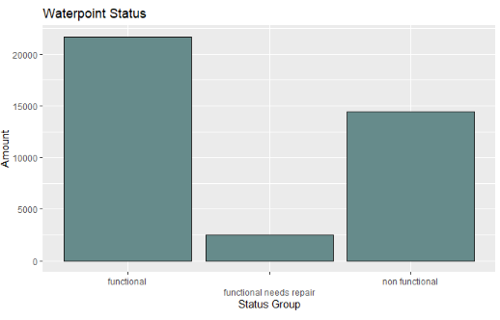
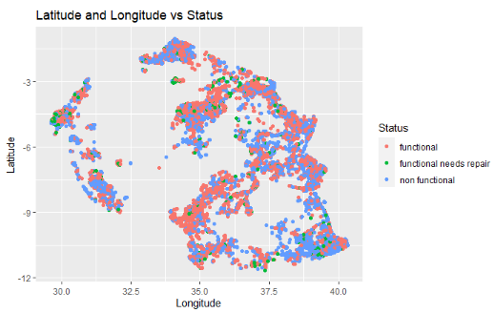
Waterpoint Status

Slide 7
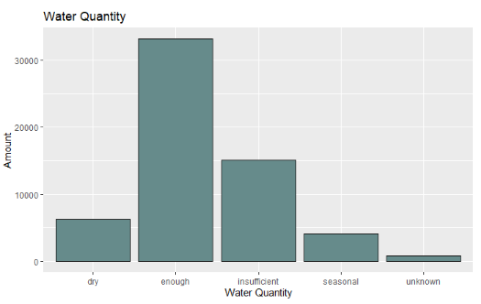
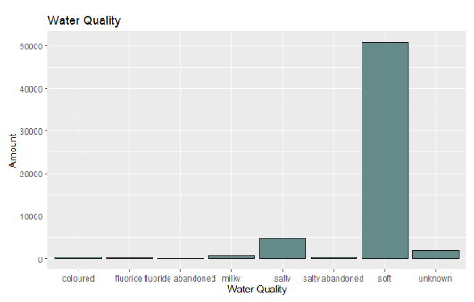
Water Quantity and Quality

Slide 8
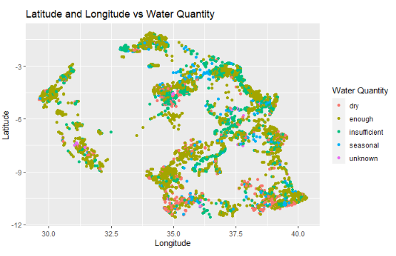
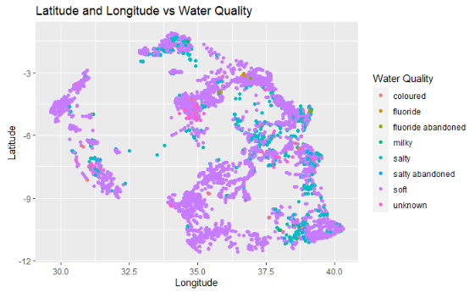
Water Quantity and Quality by Location

Slide 9
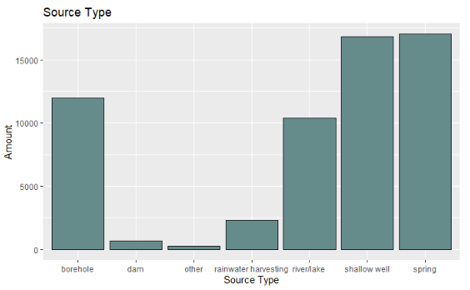
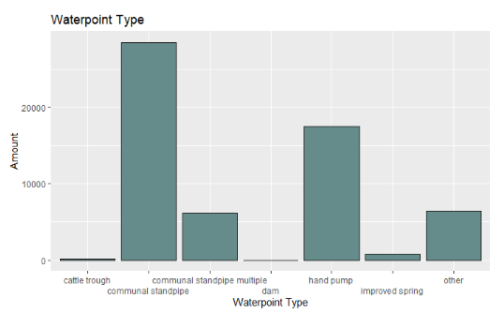
Waterpoint Sources and Types

Slide 10
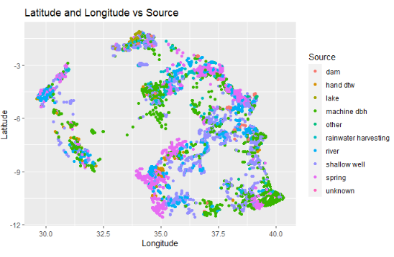
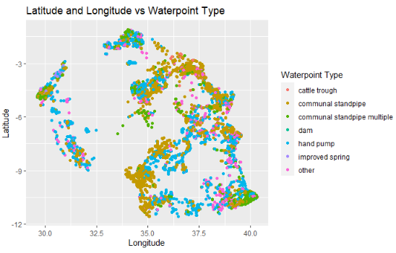
Waterpoint Sources and Types by Location

Slide 11
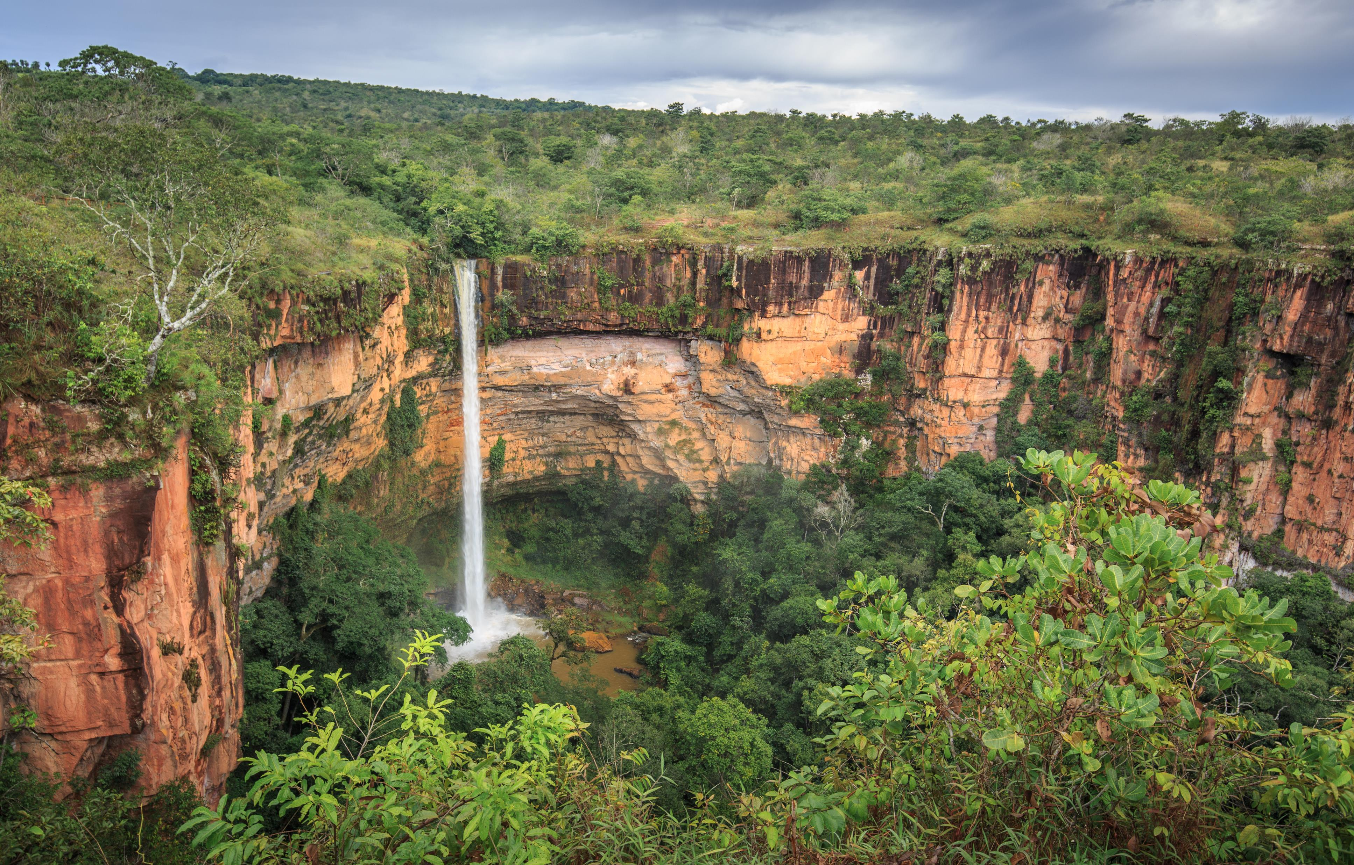
Conclusion
Model will take 42 days to create
Low cost
Sending resources where they’re needed

Slide 12
References
Britannica. (2020). Tanzania. Britannica. https://www.britannica.com/place/Tanzania
Drivendata. (2021). Pump it Up: Data Mining the Water Table. Drivendata.
https://www.drivendata.org/competitions/7/pump-it-up-data-mining-the-water- table/data/
Iliffe, M. (2014). Accelerating With GWOB. Wordpress.
https://taarifa.wordpress.com/2014/09/11/accelerating-with-gwob/
Kelleher, J. D., Mac Namee, B., & D’Arcy, A. (2020). Fundamentals of Machine Learning for Predictive Data Analytics: Algorithms, Worked Examples, and Case Studies (2nd ed.). Massachusetts Institute of Technology.
Rathgeber, F. & Gorissen, D. (2020). TaarifaWaterpoints. GitHub. https://github.com/taarifa/TaarifaWaterpoints
Water.org. (2021). Tanzania. Water.org. https://www.water.org/our-impact/where-we-work/tanzania/

